Slide 1
Free RTOS G3 Platform
Real Time operating system

Slide 2
Real Time Operating System
Realtime operating system allows for modular code development
Provides predictable operation timing
Allows for data and resource hiding
Manage complexity -- an RTOS (or most OS flavors) can help with this. By allowing the project to be decomposed into independent threads or processes
Meet real-time deadlines - with a priority-based pre-emptive RTOS, your scheduler can help ensure deadlines are met.

Slide 3

Free Rtos Features
Pre-emptive or co-operative operation
Very flexible task priority assignment
Flexible, fast and light weight task notification mechanism
Queues
Binary semaphores
Counting semaphores
Mutexes
Recursive Mutexes
Software timers
Event groups
Tick hook functions
Idle hook functions
Stack management overflow checking
Trace recording
Task run-time statistics gathering
Full interrupt nesting model (for some architectures)
A tick-less capability for extreme low power applications
Software managed interrupt stack when appropriate (this can help save RAM)
Dynamic or Static Memory Management

Slide 4
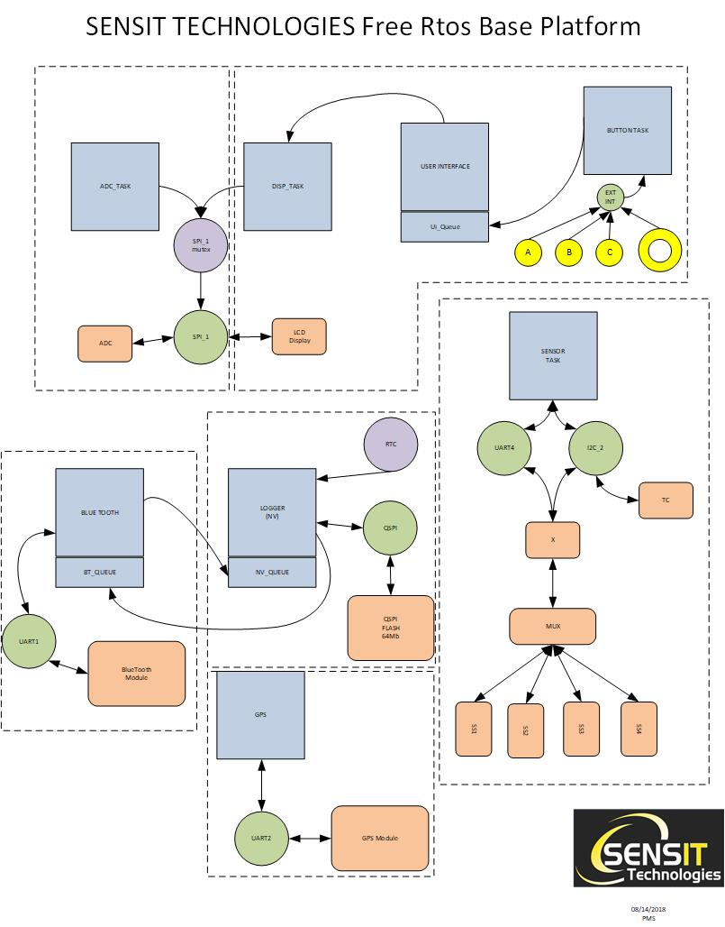
Free Rtos Base Platform
Made up of functional modules consisting of single or multiple Tasks to isolate required functionality
Each Module can be tested and validated independent of final product

Slide 5
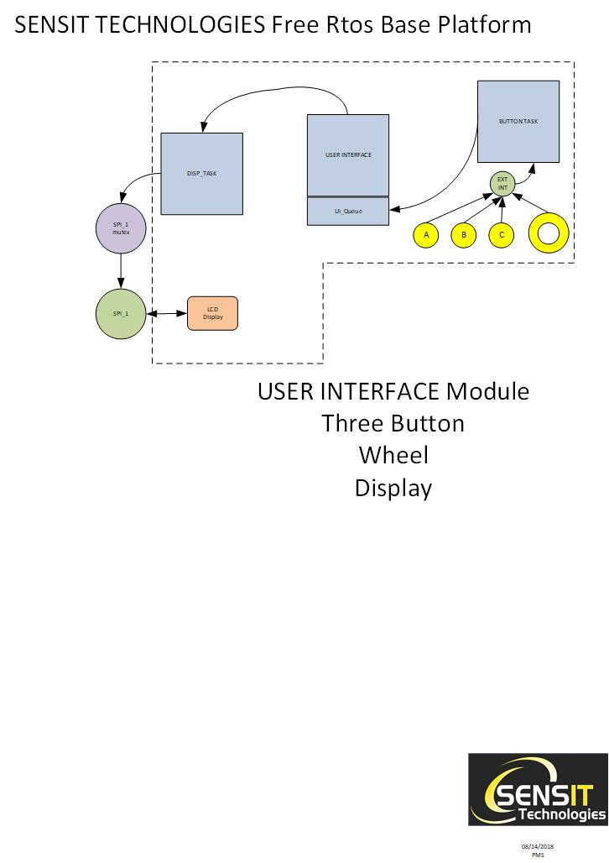
User Interface
Contains all the functionality required for the user interface
Supports the three button interface
Supports the click wheel
Manages the menu system
Interfaces to the Display module

Slide 6
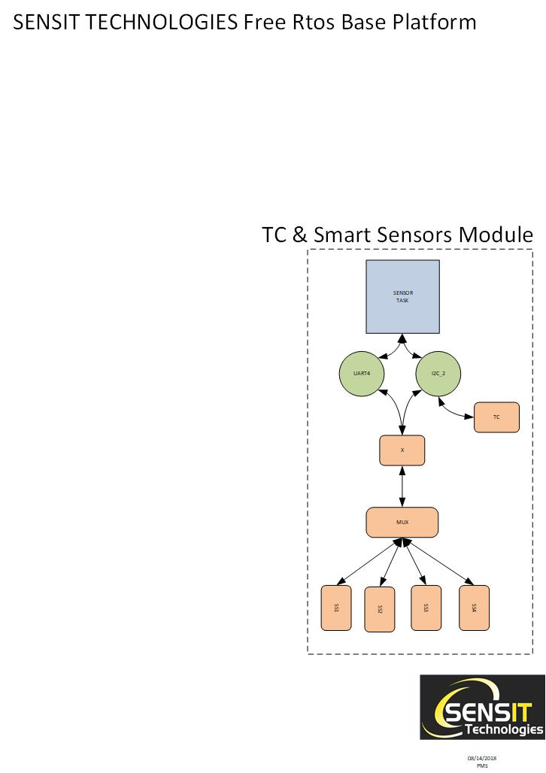
TC & Smart Sensor Support
Smart Sensor interface will be consistent between products
Can be included in any Rtos based product that requires the smart modules
Isolated from end products use case
Can be tested once and validated

Slide 7
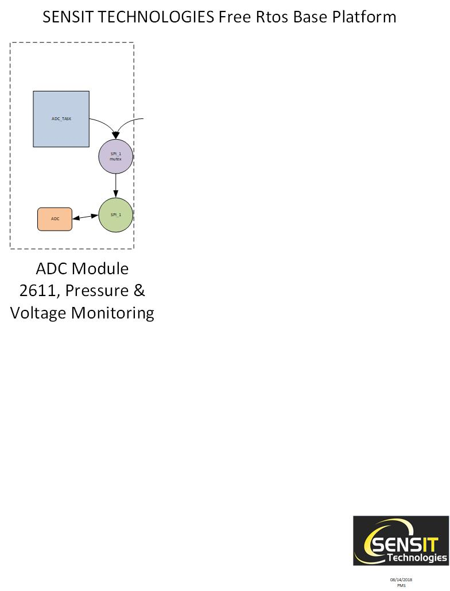
ADC Module
Supports 2611 voltage monitoring at 24 bit resolution
Supports Pressure sensor monitoring
Performs background voltage monitoring for battery and platform validation

Slide 8
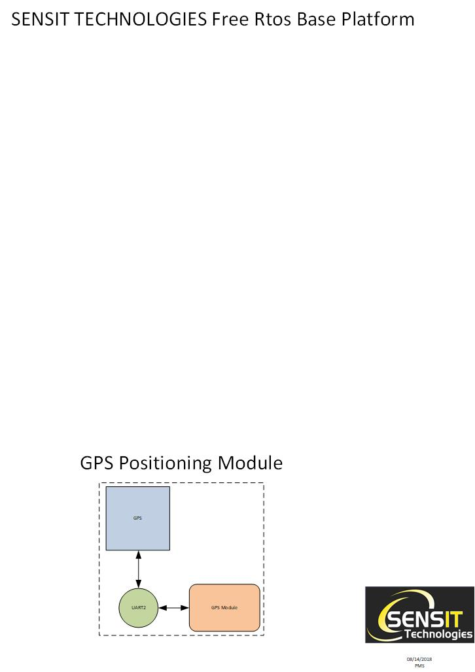
GPS Positioning Module
Allows for precise time and position tracking of log data
Can be offered in different levels of precision
Can be included or omitted from any product without effecting the rest of the system.

Slide 9
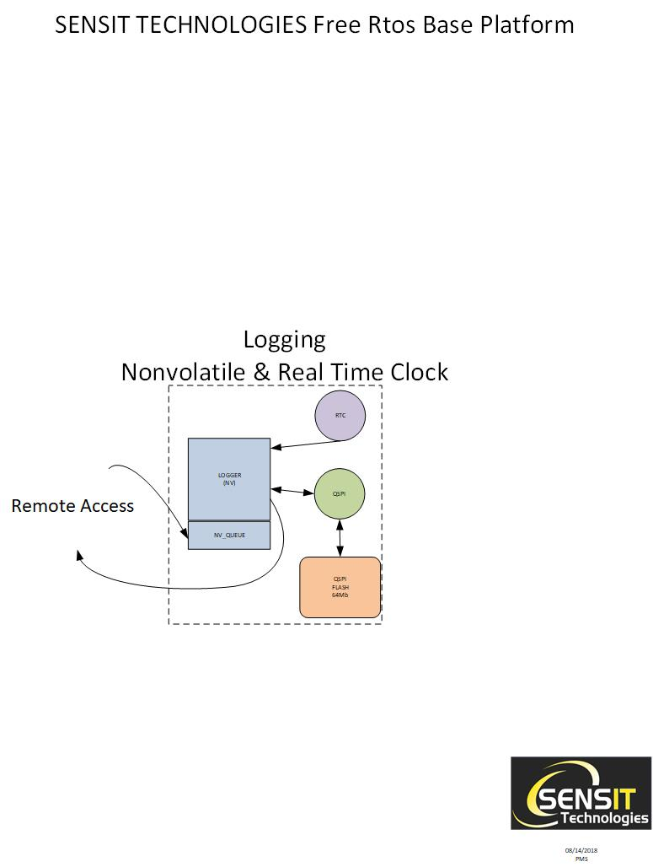
Realtime Clock and Logging Module
Logging Module supports 144,000 auto log records
Auto Log Records include
All sensor readings
GPS position data
UTC timestamp

Slide 10
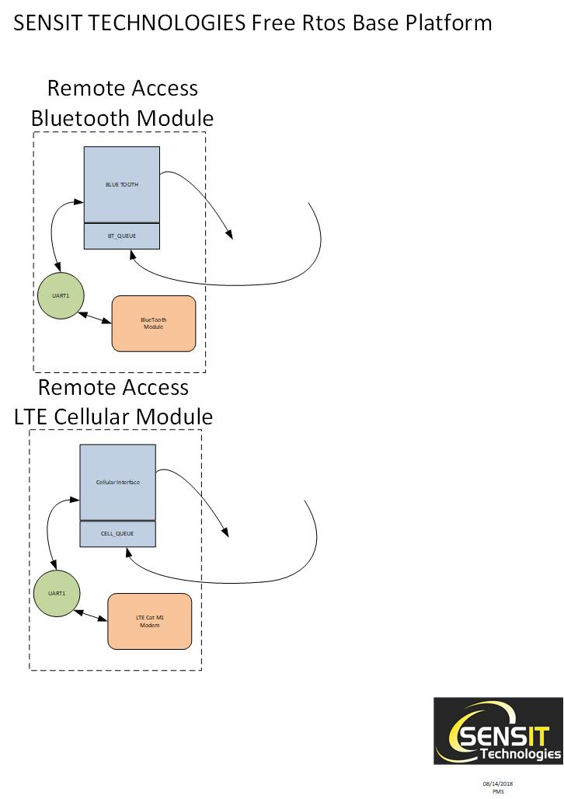
Remote Access Module
Initial G3 supports the Bluetooth module for data upload and audio interface
Can be replaced with Cellular module for real-time data upload
Both simply interface to the logging system to provide requested data

Slide 11
Platform Reuse
Traditional design goals are to allow for code reuse on a second platform
We are proposing platform reuse.
Using the same processor (<$10)
Select from software modules per product
Select hardware modules
Develop minor software changes to support product identity menus
Allows for a family of product to be developed in slightly longer that a single product.

Slide 12
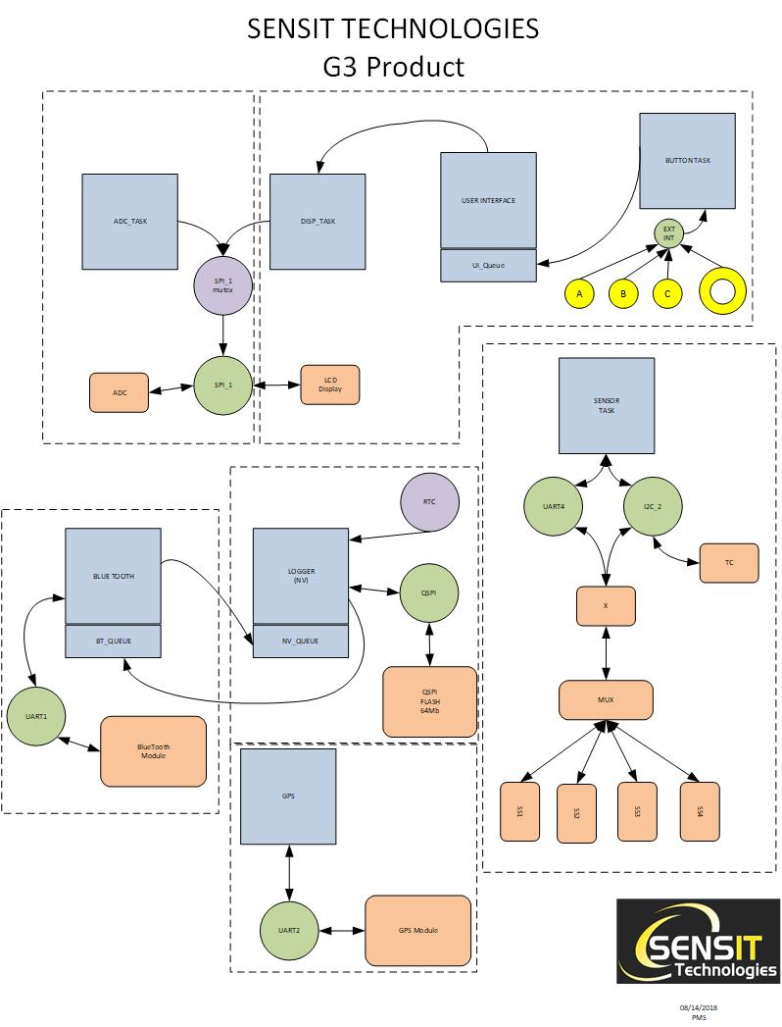
G3 Product
Supports all known product requirements

Slide 13
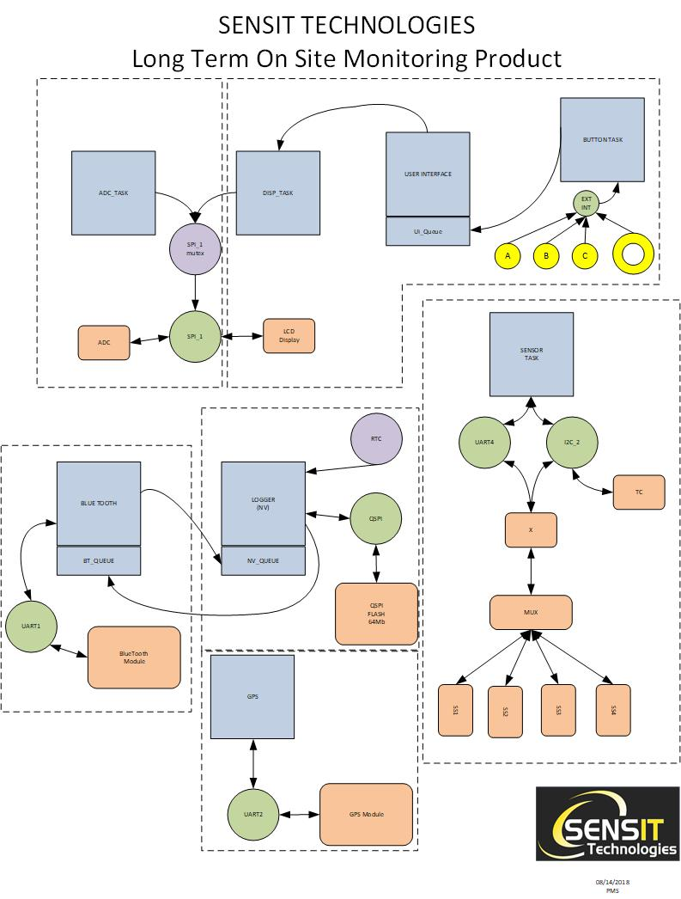
Long Term Monitoring Product
Replace The batteries for a longer term power source
Change the auto log from once a second for 16 days in G3 to once every 10 sec for over a year days.
No other change to hardware or software beyond product id menus

Slide 14
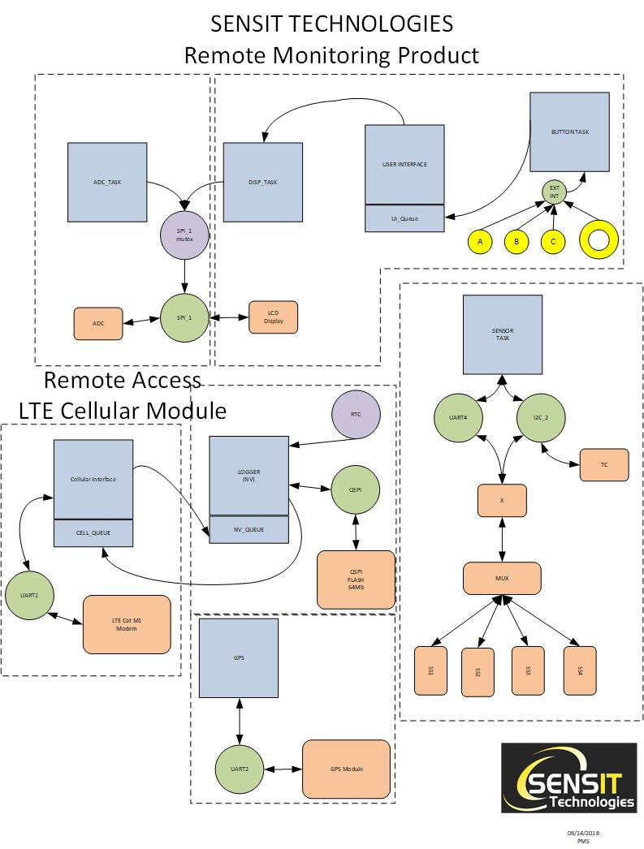
Remote Monitoring Product
Replace the Bluetooth module with LTE Cat M1 Modem
Both Modules use AT command interface
Single Task addition with similar functionality
Real Time data upload for on site monitoring.

